Slide 1
Exploration of Transfusion & Survival in Canine Trauma
Valerie Chavez and Shannon Jaskiewicz
Notes:
Valerie and Shannon

Slide 2
Background & Aims
VetCot Registry
Aim 1
Aim 2
Aim 3
Modeling Transfusion
Modeling Survival
Descriptive Statistics
Univariate & Multivariate
Univariate with cutoff points & Multivariate
Transfusion & trauma types, description of patients
Notes:
Valerie:
Will focus on the analysis approach for the first two aims today, and highlight the results from aim one but of course all of these have been explored and considered
Are interested in 8 predictors of blood transfusion and survival
With two outcomes (Blood transfusion and Survival, both of which we treated these as binary classification problems)
We explored a few approaches, we fit many variations of logistic regression, and we explored Machines random forest for both transfusion and survival
Why is this important? - To saves dogs lives and improve recovery! It would be nice if Vet Trauma professionals had clear guidelines to help make timely decisions in emergency

Slide 3
Effective Sample Sizes
 | ATT score | Abdominal Fluid Score | Blood Lactate | Base Excess | Ionized Calcium | Packed Cell Volume | Total Solids | Blood Glucose | Multivariate model
Normal Range | 0 - 18 | 0 - 4 | >0 | -32 to 25 | <2 | <100 | <12 | 20 to 600
Total Outliers | 0 | 0 | 1 | 0 | 359 | 3 | 7 | 16
Total NAs | 30 | 24,034 | 23,585 | 24,770 | 24,150 | 20,737 | 20,839 | 20,079
Effective Sample Size | 30,583 | 6,579 | 7,027 | 5,847 | 6,105 | 9,873 | 9,767 | 10,518 | 2280
Notes:
Valerie
Started with ~30,000 observations
Removed outliers
Removed NAs for predictors and response variables (4 observations were missing either a transfusion or a survival variable)
Recoded Survival from 3 categories to binary to treat all of our models as binary classification (survived vs (passed away or euthanized were combined)) were combined for modeling
But we will provide summaries of the subcategories
All variables were treated as numerical and continuous (although ATT and Abdominal Fluid are ordinal)
This is often done
“Normal Ranges” I’ll say these were what were provided by the researchers when removing outliers

Slide 4
Limitations and challenges
Imbalanced classes
Transfusion Variable
High prevalence of missing data
Both response variables have highly imbalanced data
Our effective sample sizes are much smaller than the ~30,000 observations
We are modeling based on if a transfusion is received, not if it is needed
Notes:
Shannon
Imbalanced classes: — both of the response variables have EXTREME class imbalance
only 1.25% of the more-than-30,000 dogs had Transfusions
6.5% of these dogs passed away
Why is this important? Classification algorithms rely on having balanced data—if our data are imbalanced, these algorithms will heavily favor the majority class for their predictions—this presents serious problems because:
the model will present as achieving high accuracy by assigning everything to the majority class, and we might not have enough observations from the minority class to make good predictions
So there might be dogs needing transfusions who are not captured
We also had a high prevalence of missing data
Particularly when we attempt multi-variate models, we need to take complete cases (so we throw away a lot of observations) shrinks our sample size to 2280
Transfusion Variable
We want to be careful w/ our language and stress that what are actually modeling w/ transfusion is those who received transfusions—we are not actually modeling who NEEDS a transfusion

Slide 5
Statistical Methods - Logistic Regression
Baseline Model
3. Prior Weights
2. Classification threshold
Specifying prior weights within the glm model
Began by fitting a classic logistic regression
Adjusted thresholds for prediction
Total Protein Solids | Pred Accuracy | Sensitivity and PPV | Specificity and NPV
M1. | 96.6% | 2.1%/46.7% | 99.9%/96.7%
M2. | 71.5% | 66.8%/7.6% | 71.7%/98.4%
M3. | 71.8% | 62.1%/73.2% | 80.2%/70.8%
M4. | 71.5% | 61.6%/73.1% | 80.2%/70.4%
M5. | 71.7% | 61.3%/73.6% | 80.7%/70.5%
4. Upsampling
5. Downsampling
Increased observations from minority class
Decreased observations from majority class
Notes:
Shannon
we applied different versions of a logistic regression model
Baseline Model
We started by fitting a classic logistic regression with the each predictor and the transfusion response variable
As you can see in the chart, this tended to misclassifying everything as the majority class
The next four models apply weighting techniques to try to account for this imbalance
Models 2 & 3 both still use the full effective sample size
We adjusted the weights of each class to account for the imbalances, and did so at different points in the analysis
So in model 2, we fit the model just as we fit the baseline model, and then applied different probability threshold for classification
For model 3, we adjusted the prior weights ahead of time so that the minority class would be more heavily weighted during the modeling process.
For models 4 & 5 we experimented with sampling to adjust the classes to a 50/50 split (different from the effective sample size)
So, in model 4, we randomly sampled from the transfusion cases, to bring the data set into balance, which means we are repeating observations from the minority class
So, in model 5, we randomly selected a subset of non-transfusion cases to bring into balance with transfusion/non-transfusion cases
We see in the chart that our ability to properly classify transfusion cases is increased considerably — the results are different for each of the predictors

Slide 6
Statistical methods - Machine learning
Tree vs Other approaches
Random Forest
Var | Cut point | Pred Acc | AUCROC
Blood Lactate | ≥ 5.05 | 87.82% | 0.69
Base Excess | < -6.08 | 92.30% | 0.73
PCV | < 28.5 | 93.97% | 0.69
Total Solids | < 4.575 | 92.58% | 0.75
Glucose | ≥ 146 | 90.35% | 0.72
iCa | < 1.485 | 95.74% | 0.53
AFAST | ≥ 2 | 93.01% | 0.70
ATT | ≥ 4 | 87.59% | 0.88
Benefit of having an easily interpretable “cut point”, few predictors
Performed better than simple decision tree with more tuning parameters (in R)
Weighting
Nodes
Forced number of nodes to have clear decision boundaries
Balanced data by reweighting the sampling classes (10:3) ratio. 80/20 training/test split
Notes:
Valerie
As I was thinking of possible approaches, it seemed that a decision tree might be best for finding clear cut points and it would be more appropriate when working with univariate or few predictors (as compared to more “deep” learning models, like a neural-net, but that doesn’t give us much information about the variables). Other methods might provide high accuracy, but we would sacrifice interpretability of our prediction variables.
Initially attempted the ctree (decision ctree function in R), but that had less tuning parameters, and really just misclassified everything as the majority class. Random forest had more tuning parameters within R
Fit using RandomForest In the RandomForest R package, I know there are a few ways we could do this, but that is what we landed on
For both survival and transfusion, we fit univariate models with the 8 predictors. Then also looked at multi-variable models. Initially explored covariates, but using univariate models made it simpler to provide cut points and the covariates were almost always less important on the variable importances, (tried weight and trauma type and blood transfusion within survival)
With all of the models I fit I took an 80/20 split of training and test data, with the test data uses to assess accuracy and evaluate model fit.
I adjusted the weights of the sampling classes to to account for the class imbalance with a 10:3 ratio of the majority to minority classes.
In the case of transfusion, I forced there to be 2 nodes so that we would get a strict cut-off point for our transfusion classification and those are summarized here along with the prediction accuracy and area under the ROC curve.
ATT performs the best with Base Excess, Total Solids, and Glucose doing reasonably well, and the rest certainly not doing well enough to save lives. Again, just want to caution against looking at accuracy alone and the AUC would probably be a better metric for evaluation

Slide 7
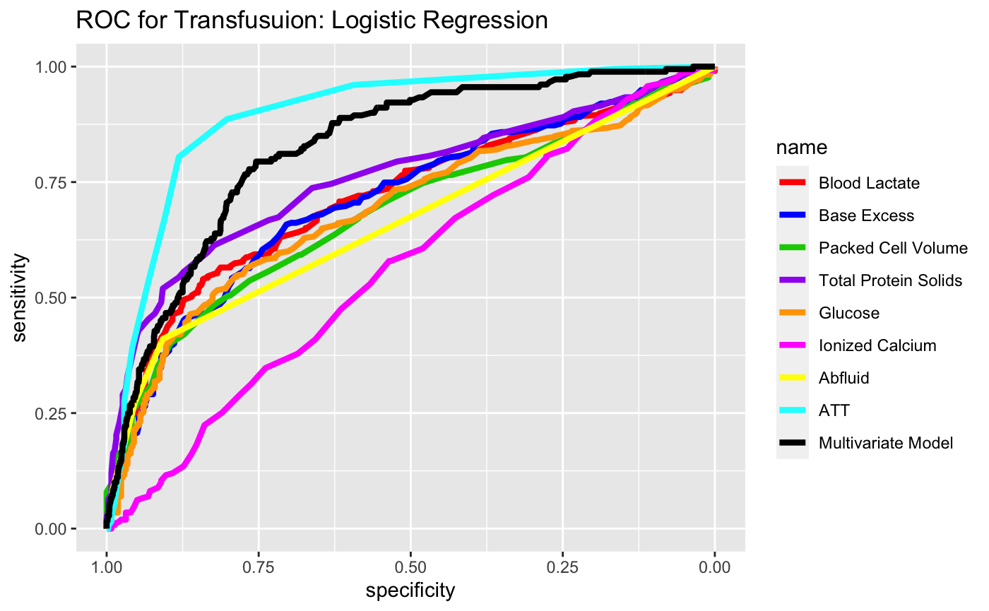
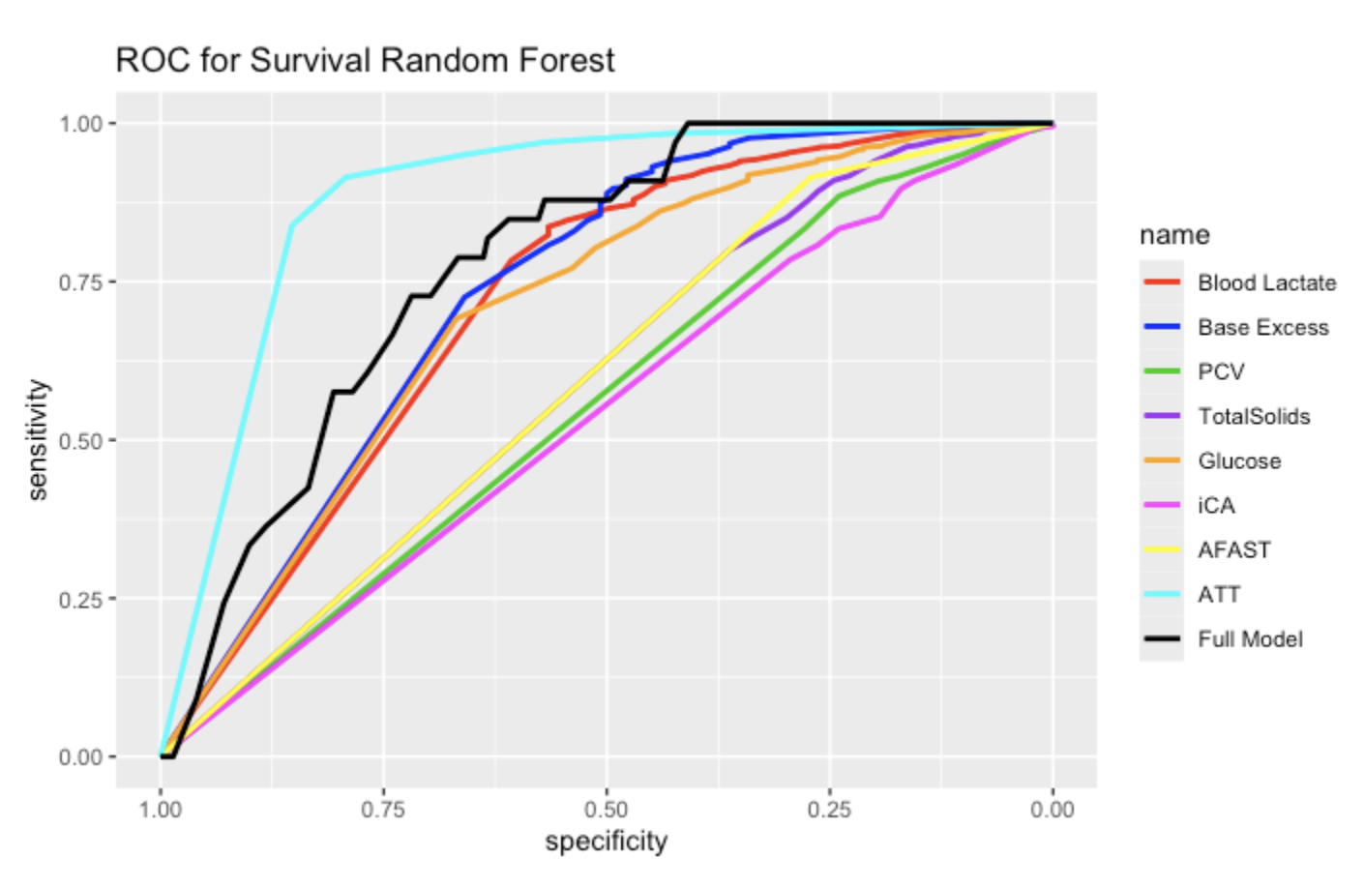
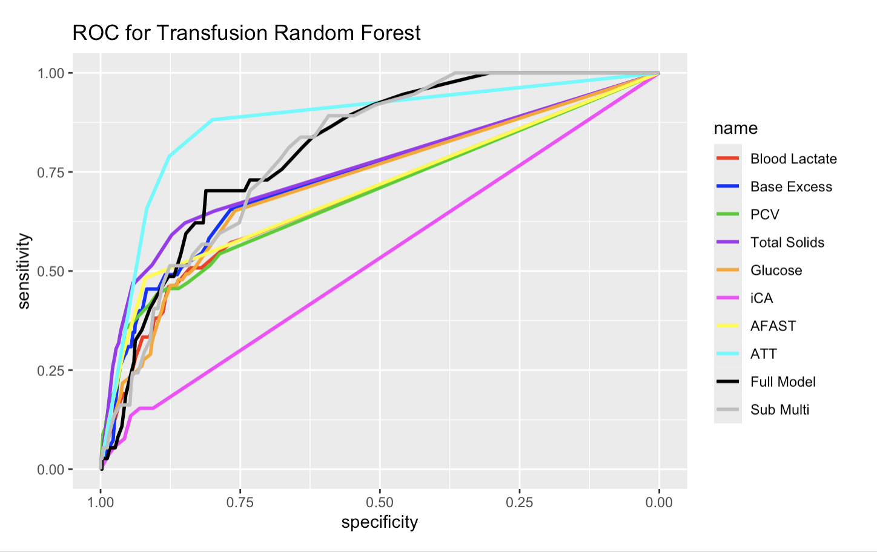
Notes:
Shannon
Let’s dig into the preliminary results
The logistic regression results will be forthcoming in the report, we are working on deciding which of the 5 methods will be best for survival.
In all cases the total trauma score seemed to have the strongest association with both transfusion and potential for mortality
In the variable importance plot for survival, ATT was a much stronger predictor, that we did not fit a model with a subset of predictors
In all cases, it also appears that ionized calcium is probably the worst performer, and is basically uninformative (misclassified everything as the majority class
In transfusion, we can see it was a bit easier to model, you can see in the case of survival, there are several that perform almost as poorly as iCA
You can see there are some full models for the random forest, these included all predictors
For transfusion, we fit a sub model with the top three predictors based on variable importance from the full model (ATT score, PCV, and Total Solids) (GRAY LINE)

Slide 8
Our conclusions
Logistic Regression usually provides sensitivity/specificity] that is comparable or better than the Random Forest
RF provides more reasonable cut-points
Some variables seem more promising than others for modeling (iCA worst vs ATT score best)
Our multivariate models didn’t necessarily improve classification for transfusion
Survival is more difficult to model
Notes:
Valerie
We do see some slight variation in the results, based on the different methods because these methods optimize different things.
So, if the goal is to find clear cut-points that can easily be applied in a clinical setting RF could have more potential
If the goal is to make sure we are accurately classifying those in need of transfusion, logistic regression might perform better; however this requires statistical software
We didn’t spend as much time on multivariate models because we were not sure how these would be applied in a clinical setting and thought univariate cut-off points were of more interest
Survival is more difficult to model based on the findings we have so far

Slide 9
Further exploration
Exploring other covariates for survival?
Looking at how transfusion mediates survival?
Other ML algorithms?
Data balancing or resampling?
Notes:
Valerie
While it might not be in the scope of this project, there could be other covariates for survival to explore
Thinking about survival, if we believe there is a relationship with transfusion we could further explore how transfusion mediates survival.
So if we think that mortality rate was higher among those who received transfusion because experienced severely injured, this might be important to explore
We can for both response variables, explore other ML algorithms or approaches to see if those improve compared to the more “basic” random forest approach?
There are other data balancing and resampling techniques out there that we haven’t tried. We have done our best to account for this within the scope of the project, but there could be other methods out there
We could dive deeper into the ones we already did.
Explore interactions between combinations of variables
So, you might notice these all have question marks, we will see what there’s time for in the next week of the class. But, if we don’t have the opportunity to further explore this data, it’s a starting point, that maybe the researchers or others can expand upon.
Skipped this slide for the sake of time

Slide 10
Thank you
Do you have any questions?
Please keep this slide for attribution

